Slide 1
Warm Up: 3/22/17 & 3/23/17
1. How the emblems similar and different?
2. Why did each country choose to include an eagle in their emblem?
3. What do you think the specific items in each emblem represent?
4. What message is being portrayed by each emblem?

Slide 2
The Great Seal of the United States the bald eagle holds a bundle of 13 arrows in its left talon (referring to the 13 original states) an olive branch in its right talon symbolize that the United States has "a strong desire for peace, but will always be ready for war" the olive branch is usually depicted with 13 leaves and 13 olives, again representing the 13 original states the eagle has its head turned towards the olive branch, said to symbolize a preference for peace in its beak, the eagle clutches a scroll with the motto E pluribus Unum ("Out of Many, One") over its head there appears a "glory" with 13 stars on a blue field the shield has 13 red and white stripes representing the 13 Colonies | The Coat of Arms for Mexico the combative stance of the golden eagle meaning that they are ready to face the challenges the snake being devoured by the eagle means that the Mexican people will prevail over their enemies the catus, with its thorny nature, represents Mexico's challenges and trouble the eagle defiantly standing on them means that the Mexican people will overcome these challenges the Earth and Water symbols represent Mexico's indigenous origins, melded together through the colonization and racial mixing of Europeans and Native Americans the Laurel and Oak leaves encircling the Coat of Arms represent victory and the martyrdom of those who have given their lives for Mexico

Slide 3
1. What area(s) provide evidence of the United States’ desire to expand?
2. What areas of Mexico could the U.S. try to gain into to further its expansion?
3. Why is Texas a separate color in the map?

Slide 4
Think-Write-Pair-Share:
Based on each country’s eagle emblems, how is Texas statehood going to affect the relationship between the U.S. and Mexico?

Slide 5
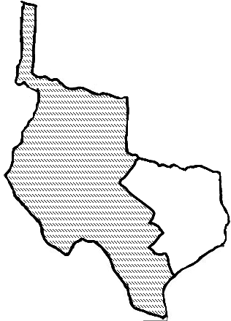
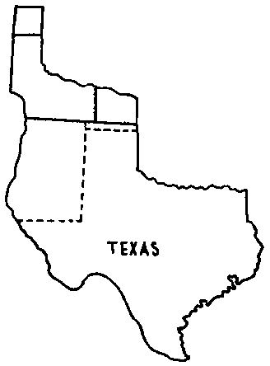
How Texas | Got Its | Shape
The U.S. - Mexican War pp.330-333 | The Treaty of Guadalupe Hidalgo pp. 334-335 | The Compromise of 1850 p. 335
Date(s)
Date(s)
Date(s)

Slide 6
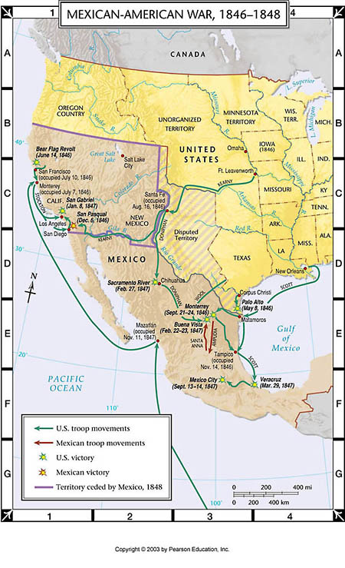
The U.S.-Mexican War or The Mexican-American War
Dates: Mar. 13, 1846-Feb. 2, 1848
Why: MX angry at Annexation of TX and border disputes
MX claimed the Nueces River the US & TX claimed the Rio Grande as the border
People Involved:
Gen. Zachary Taylor (U.S)
forced MX to attack by taking U.S. soldiers to Rio Grande to “protect” TX
Pres. James K. Polk (U.S)
He wanted a war with MX (sent Gen. Taylor to Rio Grande)
Wants land (Manifest Destiny) including CA (MX Territory)
U.S. Congress
Many members of Congress opposed the war with Mexico.
Some felt that the president had forced the U.S. into the war, which was wrong because only Congress can approve war.
Others just thought it was wrong to take any territory from Mexico.
Gen. Antonio Lopez de Santa Anna (MX)
US Advantage:
People
U.S. 17 million people (116,000 soldiers) , MX 7 million people
Technology
Artillery (bigger/better guns i.e. rifles, handguns and Colt revolver and more ammunition)
Telegraph (faster ways to communicate)
Economy
U.S. growing economy, MX in debt
Deaths:
One out of ten American soldiers died in less than two years of service
Disease accounted for 7/8 of the deaths.
Crowded, unsanitary conditions and impure water led to dysentery, lice, and other diseases that spread rapidly.
12,518 American soldiers died during the war.
The End: the U.S. under the command of Winfield Scott gradually began invading MX until they advanced to Mexico City where the city fell and the U.S. won the war

Slide 7
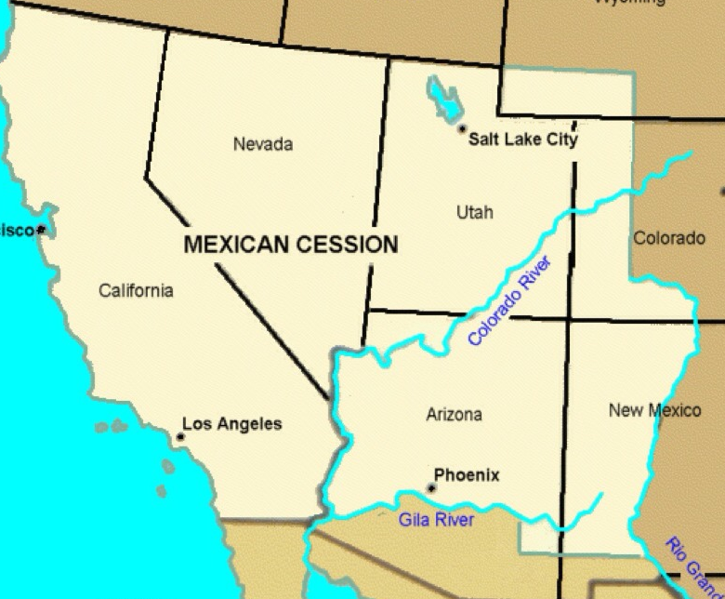
The Treaty of Guadalupe Hidalgo and the Mexican Cession
When: Feb 2, 1848
Mexico's size was halved, while the size of the United States increased by a third.
California, Nevada, Utah, most of Arizona, and parts of New Mexico, Colorado and Wyoming were all included in the Mexican Cession.
Mexico recognized the annexation of Texas and acknowledged the southern border of Texas as the Rio Grande.
Mexico received $15 million.

Slide 8
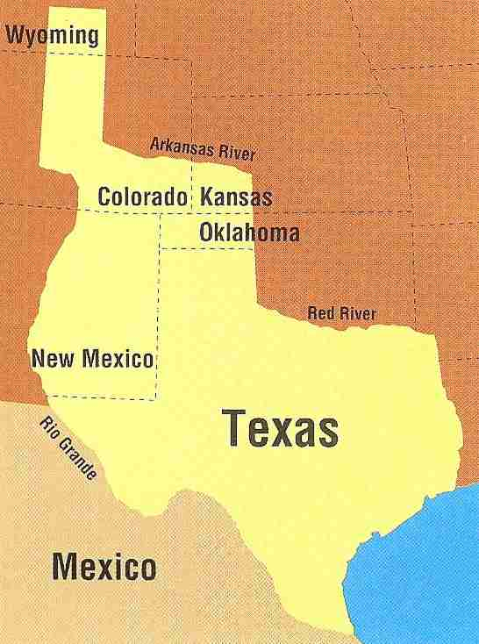
The Compromise of 1850
(in regards to Texas)
Dates: 1/29/1850—compromise proposed by Sen. Henry Clay it took 8 months to pass (CA was admitted at this time as a free state)
Why? Slavery dispute (Santa Fe which was within Texas’ border was against slavery
The plan established the border between Texas and New Mexico
Texas received $10 million dollars for northern and western land claims (agreed to pay off Texas’ debts)
The present-day borders of Texas are formed.
Texas would remain a slave state.

Slide 9
Westward Expansion: Gadsden Purchase
1853 agreement to buy a strip of land from Mexico in what is now the southern United States so that a railroad line could be built to the Gulf of California. It cost $10 million

Slide 10
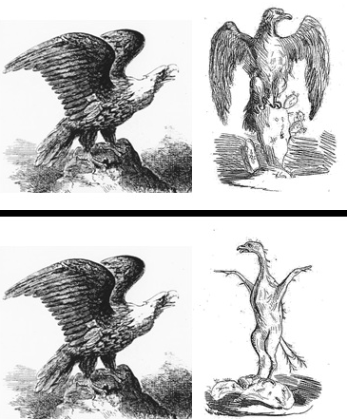
Image 1
Process: Exit Ticket
Must be written in complete sentences
Use evidence from your foldable to explain:
Who do the eagles represent in image 1?
What events would explain image 2?
Image 2

